Slide 1
Redefining Transparent. Barely there lighting.
Delivering effortless lighting that appears to be floating while having a big impact on direct/indirect ambient illumination to all surfaces. Transform carefully directs light up for general illumination while aiming it down perfectly for an even glow.
Offering one of the thinnest profiles on the market, Transform delivers on today’s needs for multi-functional workspaces that inspire collaboration and creates an imaginative workspace.

Slide 2
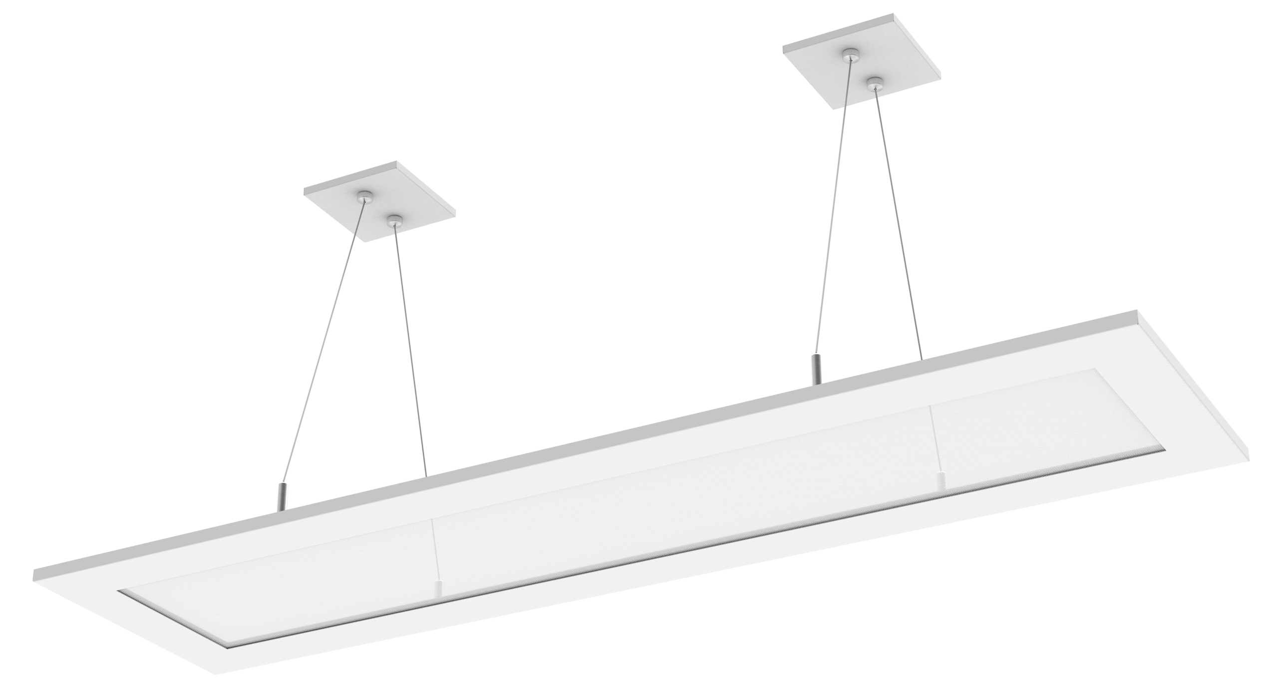
Unique Selling Features
Power over aircraft cables – no other fixture on the market offers this
Slimmest profile on the market at 0.6”
Efficacy up to 104LPW – better than GE Lumination fixture, on par with Peerless Vellum fixture

Slide 3
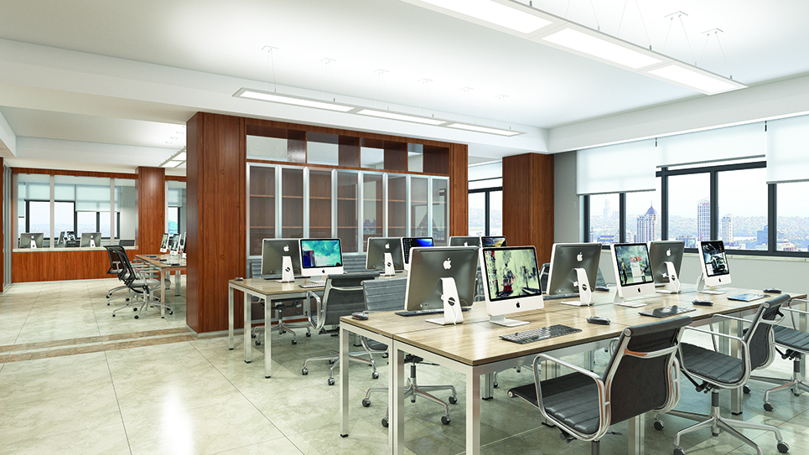
Ultra thin design. Big Statement.
Modern and solid design
100% concealed source for zero glare and great uniformity
AccuRay® Optics enabled
Rincon® powered suspension technology
3000K, 3500K, 4000K
Staggered or continuous rows with bracket accessories
Standard dimming 10% - 100% range
L70 at 60,000 hours
5 year limited warranty

