Slide 1
NATA – Unique Selling Features
Up to 122 LPW - Highest efficacy when compared to Kenall and Eaton
80+ CRI standard on fixture with option to increase to 90 CRI –competitors offer 70-80+ only
Currently only Natatorium fixture on the market that offers Direct/Indirect – benefit to end user as they won’t require additional fixtures to create downlight
Direct replacement for Metalumen’s existing AW7
No adjustable mounting brackets to avoid incorrect installation on site

Slide 2
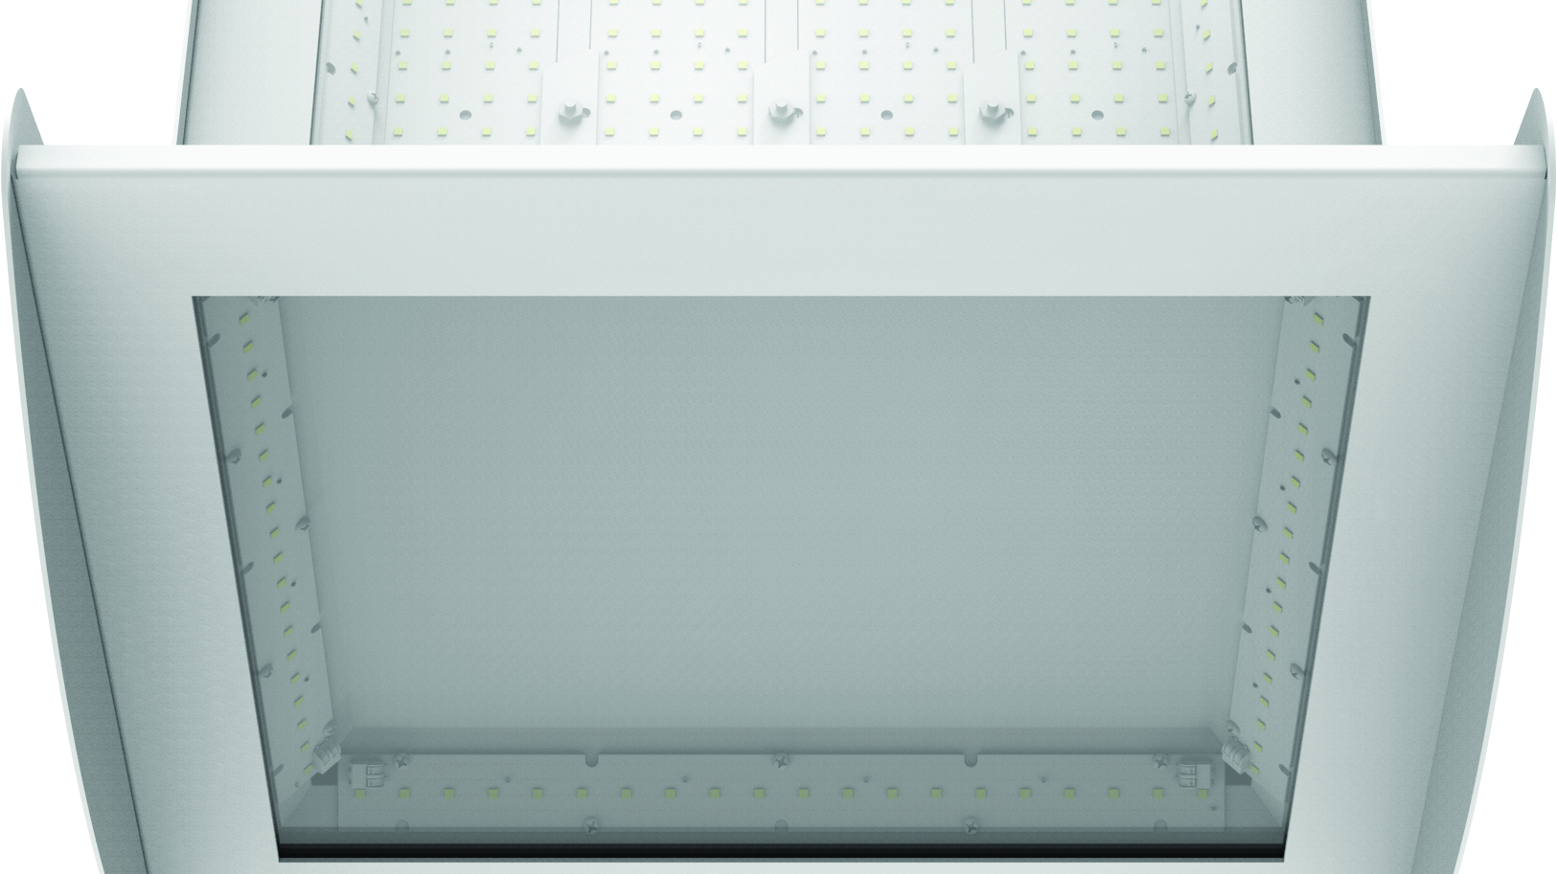
Designed and Built to Last
Aesthetic design – different from all other rectangular/boxy designs
Maximizes performance while minimizing glare – ideal for reflective surfaces
NATA’s durable finish protects from exposure to chemicals most often found in pool locations
Anti corrosion, hard wearing and watertight delivering low maintenance requirements and low cost of ownership
Blend in or stand out against ceiling using any of our standard, premium or custom paint finishes

Slide 3
Efficient and Cost effective
Get the same outstanding lumen output as our AW7 but with all of the benefits of LED efficacy. Making the switch from our AW7 fixture to our new LED NATA will offer energy savings up to 53%!
When comparing NATA to a competitive fixture currently available in the market, we are pleased to demonstrate energy savings up to 18%
MODEL | LED WATTAGE | Efficacy (LPW) | HID LAMP | AW7 HID WATTAGE | Retrofit Energy Savings | Energy Savings vs Competitor
NATADI-L1 | 128 | 122 | 250 | 275 | 53% | N/A*
NATADI-L2 | 236 | 114 | 400 | 440 | 46% | N/A*
NATAI-L1 | 129 | 120 | 250 | 275 | 53% | 18%
NATAI-L2 | 242 | 109 | 400 | 440 | 45% | 10%
* The specific competitor we compared against does not offer a Direct Indirect option

Slide 4
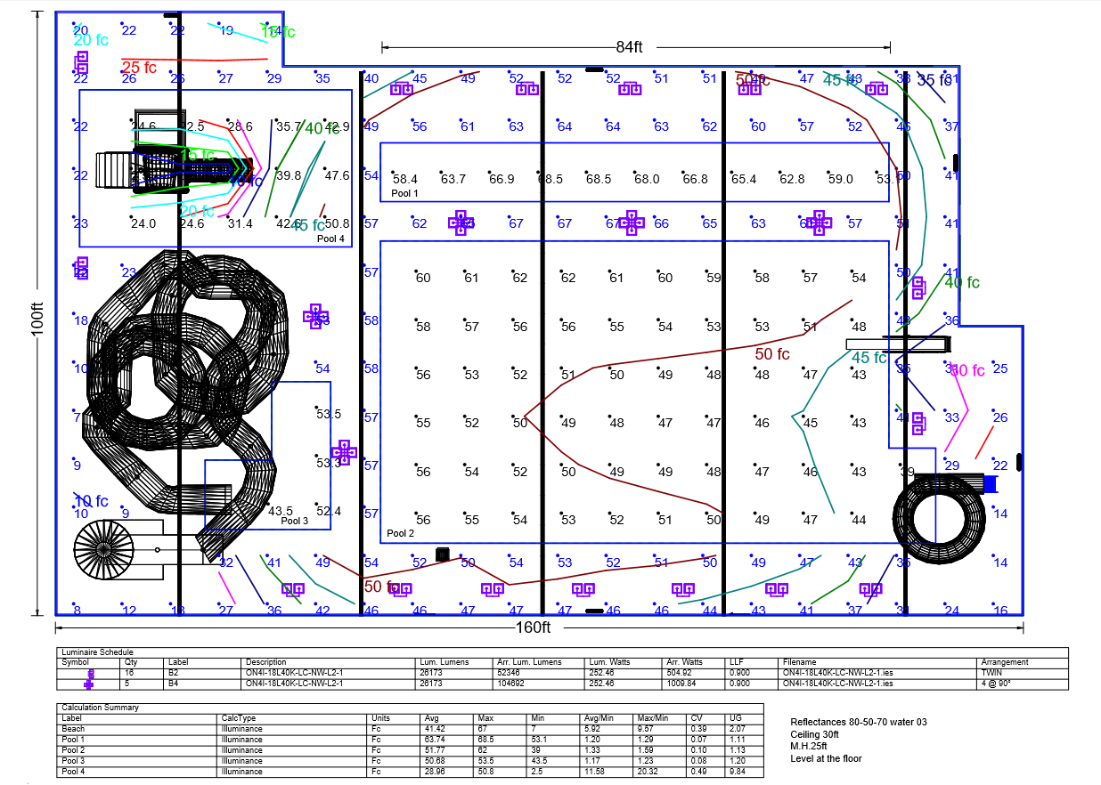
Lighting Calculation Study

Slide 5
Choosing the right NATA replacement is easy
When ready to replace your existing AW7 fixture, simply find it on the chart below and choose the corresponding NATA fixture.
Luminaire type
AW7 |  | NATA
AW7-D36-W-I-1 |  | NATAI-1835K-LC-NW-L1-1-4-I
AW7-D37-W-I-1 |  | NATAI-1835K-LC-NW-L2-1-4-I
AW7-C36-W-I-1 |  | NATADI-2235K-LC-NW-L1-1-4-I
AW7-C37-W-I-1 |  | NATADI-2235K-LC-NW-L2-1-4-I
Mounting type
AW7 |  | NATA
AW7 SW |  | NATASW-I/R
AW7 DW |  | NATADW-I/R
AW7 DA |  | NATADA-I/R
AW7 DP |  | NATADP-I/R
AW7 DQ |  | NATAQP-I/R
Once you know which fixture you want to order, simply use the NATA retrofit kit spec sheet to determine part number

Slide 6
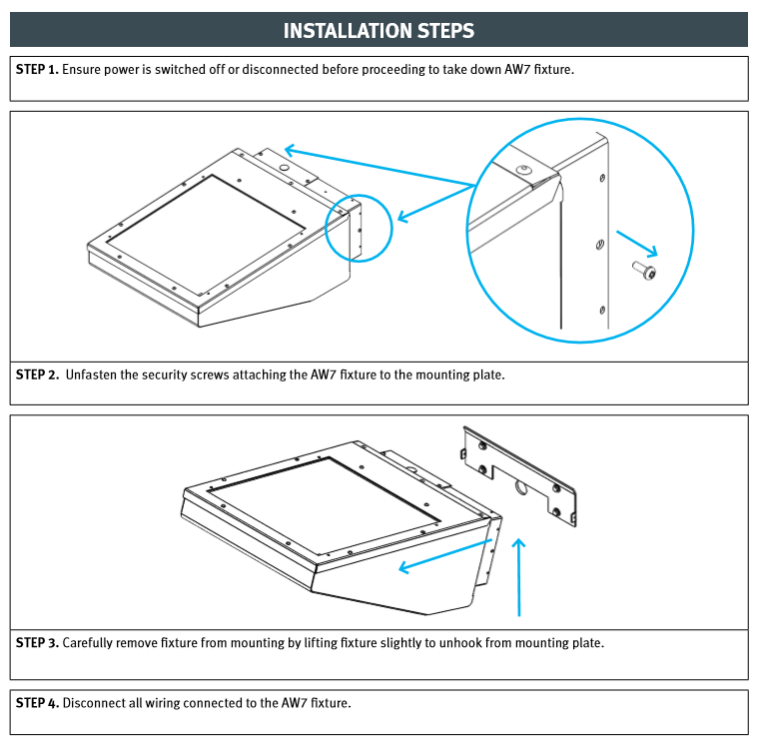
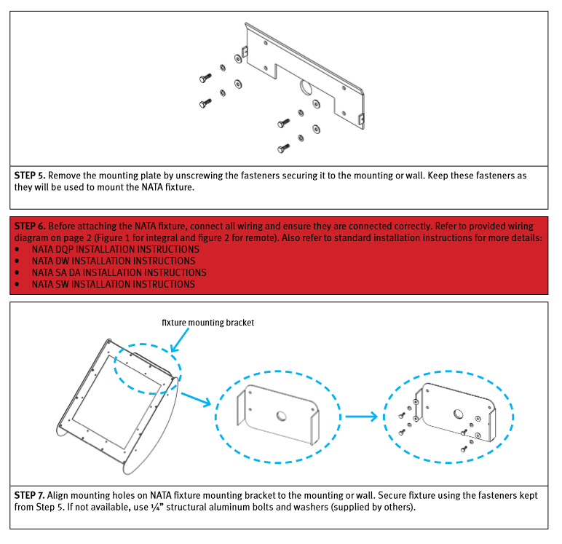
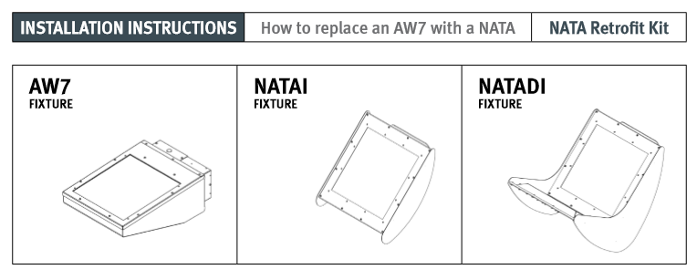
Clear Installation Instructions
Once you’re ready to install your NATA, we have clearly listed dismantle instructions for the AW7 so you can easily make the switch to the NATA

