Slide 1
Perimeter Sales Presentation
Perimeter, RP4D
May 2018

Slide 2
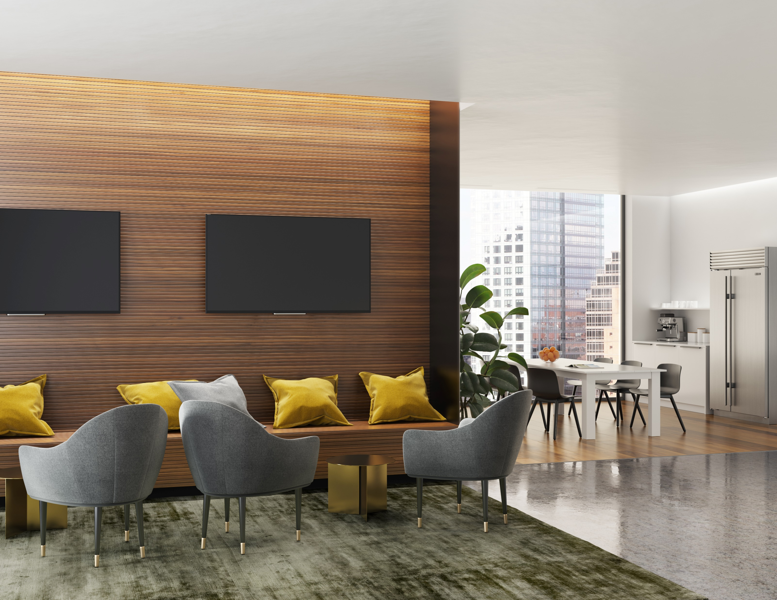
WHY CHOOSE
RAIL 4 PERIMETER
Available in flush and 3” regress
Smooth lines of light with no pixilation or shadows
3000K, 3500K, 4000K
0-10V standard dimming
80+ and 90+ CRI options available
Continuous runs and 90° corners
12” Telescopic for precise lengths, cut on site
Plenum (UL pending)

Slide 3
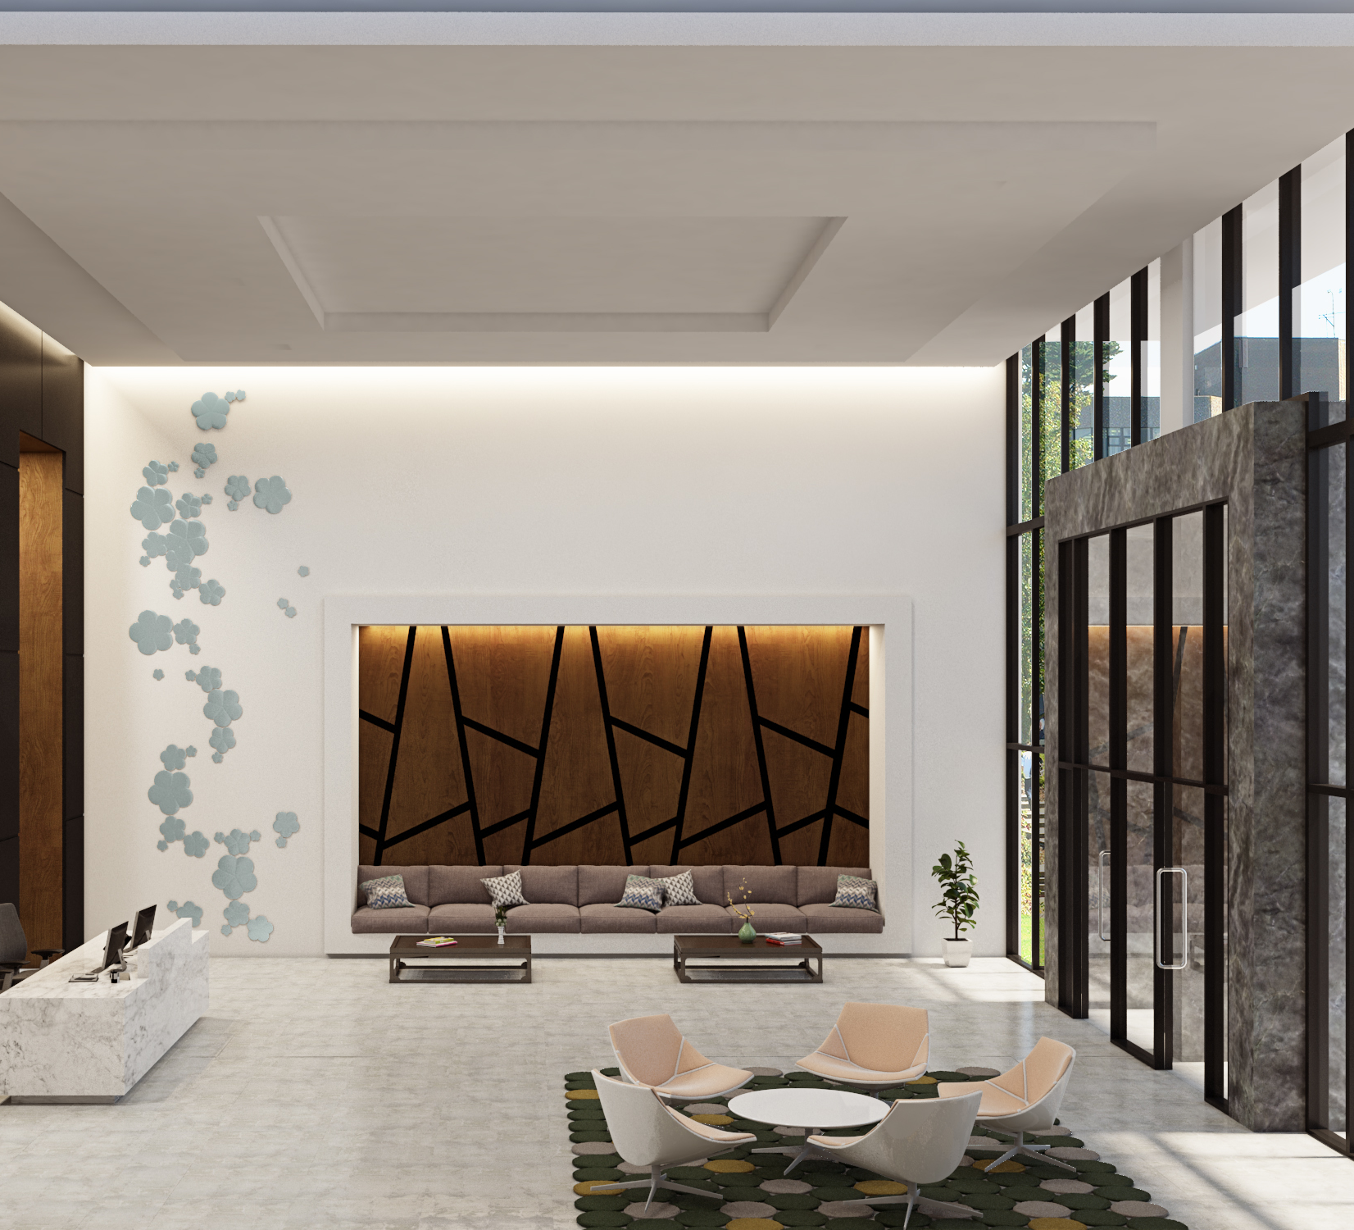
AMBIENT – OPTICS & DISTRIBUTION
Angled LED array arrangement, along with a faceted asymmetric reflector, creates a unique illumination pattern that enhances wall features and illuminates the room with a comfortable level of brightness without glare
Large range in lumen package to cover all of your applications
Efficacies up to 98LPW
TYPICAL APPLICATIONS:
L1 or L2 ideal for illuminating wide hallways with light from one or both sides(ie. healthcare)
L3 or L4 light levels perfect for high ceiling or high mounting (ie. Public spaces, tower lobbies)

Slide 4
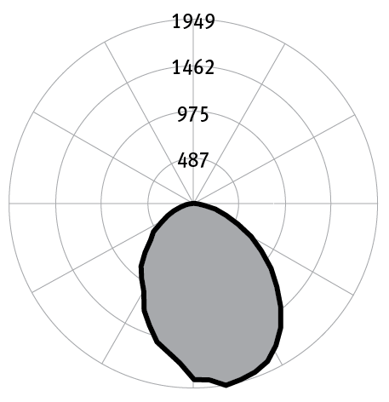
ASYMMETRIC (AMBIENT) - PERFORMANCE
L1 Light level
Efficacy: 98 Lumens per Watt
Total luminaire output: 1370 Lumens (343 Lumens/ft)
Power: 14 Watts (3.5 Watts/ft)
CCT:3500K
Total Light Output, 3500K, 80 CRI (Lumens per 4 ft)
L1 | L2 | L3 | L4
1370 | 1714 | 2330 | 4325
Light Output, 3500K, 80 CRI (Lumens per foot)
L1 | L2 | L3 | L4
343 | 429 | 583 | 1081
Power, 3500K, 80 CRI (Watts per foot)
L1 | L2 | L3 | L4
3.5 | 4.4 | 6.1 | 12.5
Efficacy, 3500K, 80 CRI (Lumens per foot)
L1 | L2 | L3 | L4
98 | 97 | 96 | 87

Slide 5
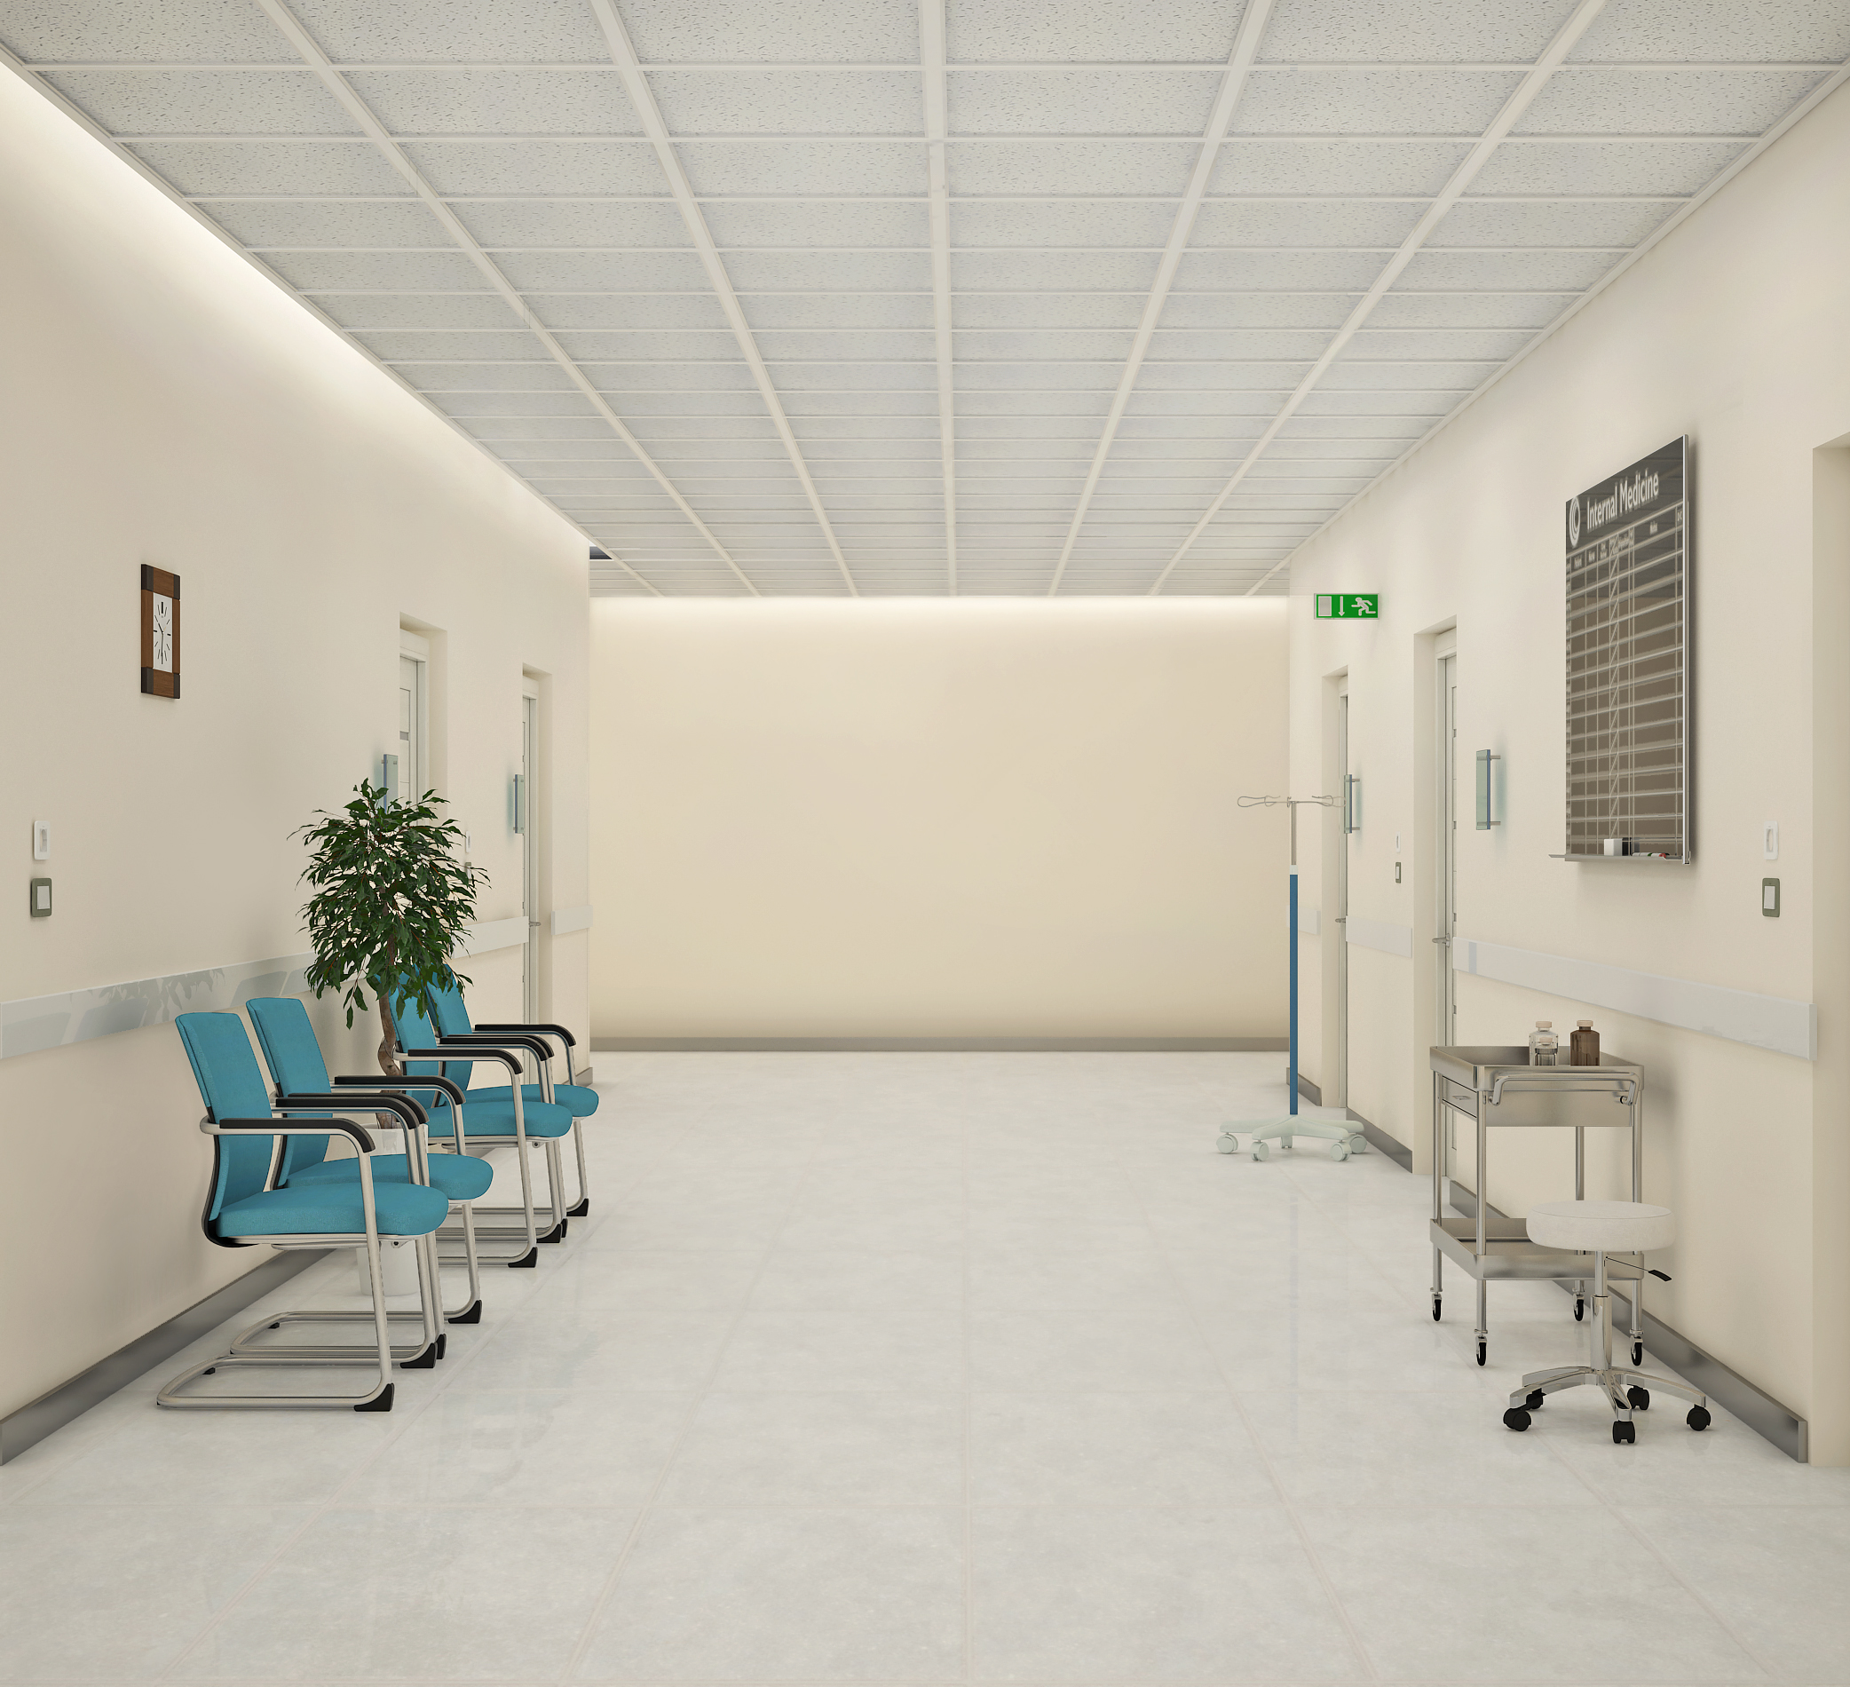
PERIMETER – OPTICS & DISTRIBUTION
LED array pointed downward and a faceted reflector profile, shape the beam into an optimal downward distribution, highlighting the transition between the ceiling and wall
Very uniform and even wall illumination creates visual interest on the entire height of the wall
Efficacies up to 100LPW
TYPICAL APPLICATIONS:
Great for corridors, reception areas or elevator lobbies
Perimeter lighting in large open office areas (wall to wall and accent lighting)

Slide 6
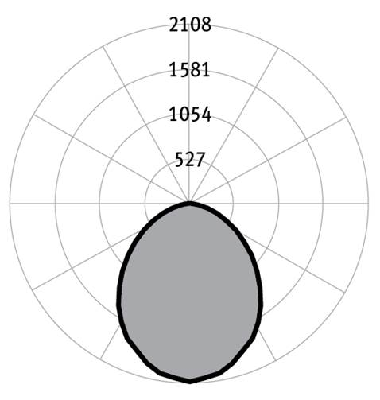
SYMMETRIC (PERIMETER) - PERFORMANCE
L1Light level
Efficacy: 100 Lumens per Watt
Total luminaire output: 1401 Lumens (350Lumens/ft)
Power: 14 Watts (3.5Watts/ft)
CCT:3500K
Total Light Output, 3500K, 80 CRI (Lumens)
L1 | L2 | L3 | L4
1401 | 1754 | 2384 | 4424
Light Output, 3500K, 80 CRI (Lumens per foot)
L1 | L2 | L3 | L4
350 | 439 | 596 | 1106
Power, 3500K, 80 CRI (Watts per foot)
L1 | L2 | L3 | L4
3.5 | 4.4 | 6.1 | 12.5
Efficacy, 3500K, 80 CRI (Lumens per foot)
L1 | L2 | L3 | L4
100 | 99 | 99 | 89

Slide 7
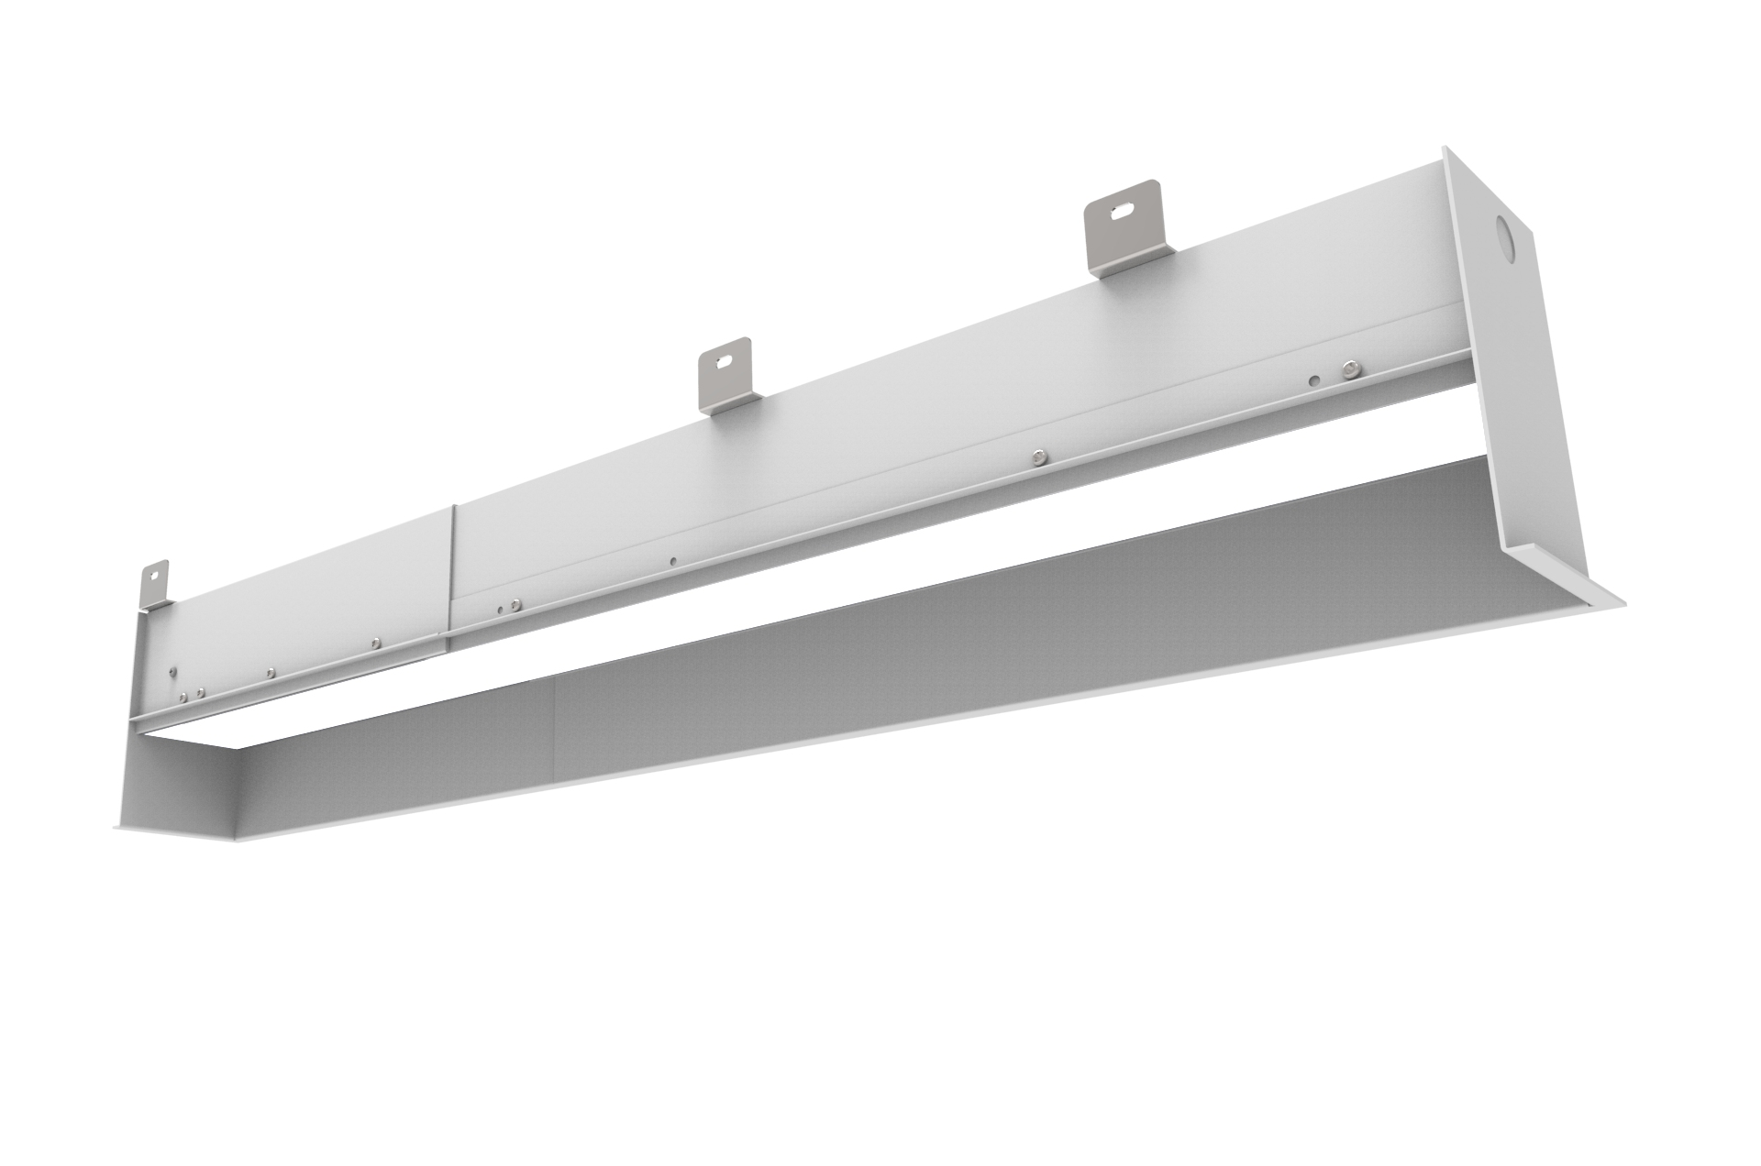
EASE OF INSTALL
Telescopic Portion for both flush and regressed available in 2’, 3’ and 4’ (+12” extension)
Benefit: offers exact fit while delivering even illumination
12” max

Slide 8
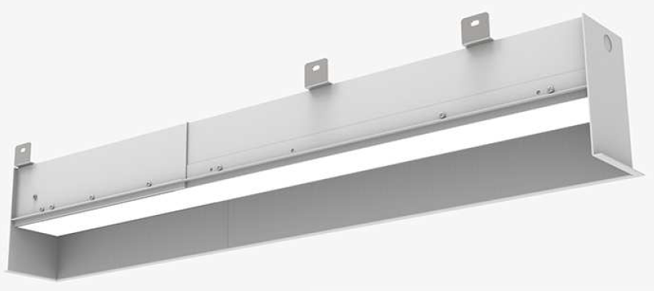
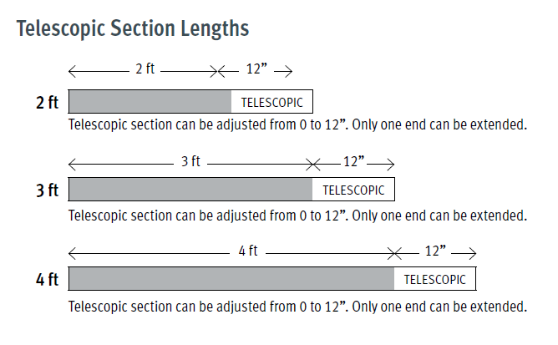
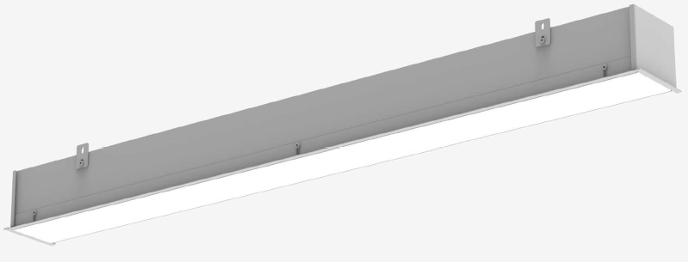
MOUNTING AND LENGTHS
Ceiling Flush Mount and 3” Regress available
Standard lengths 2’, 3’, 4’, 5’, 8’, 10’, 12’

Slide 9
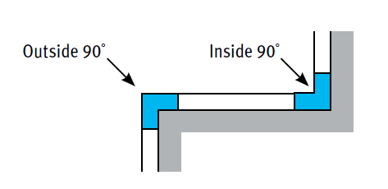
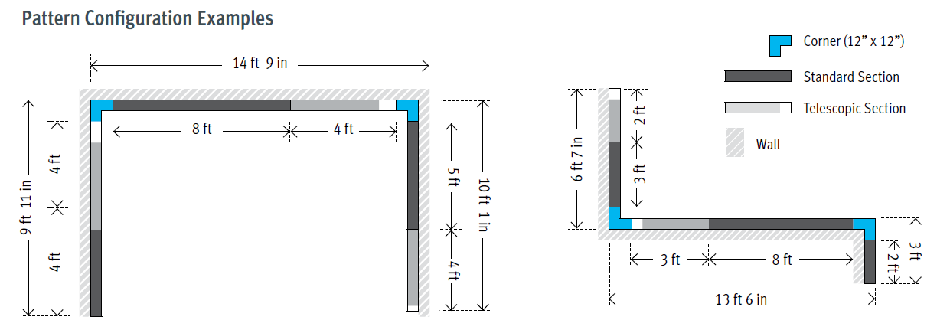
CORNERS AND PATTERNS
90° Inside and Outside corners available

Slide 10
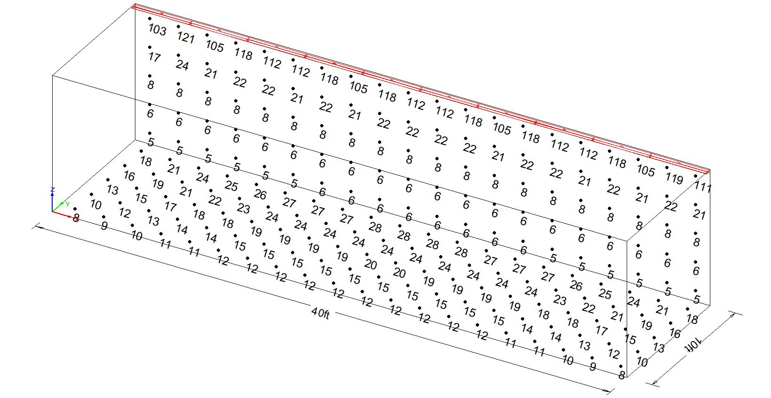
Lighting Studies - Asymmetric
 | RP4D-1L35K-4-MBA-L2 | RP4D-1L35K-4-MBA-L2
 | Wall | Floor
Average Light Level (footcandles) | 31 fc | 18 fc
Average to Minimum | 5.70 | 2.25
Room Reflectance: 80-50-20
Room dimensions: 10’ W x 40’ L
Ceiling Height: 9.5’
LLF: 0.900

